Slide 1

Unlocking Seamless AI Integration in Finance
Bevan Venter
Notes:
“Ever been stuck with the wrong charger? Finance tech feels that way too.”
State purpose: “Today we’ll meet MCP – the USB-C for AI.”

Slide 2
Road map
What is MCP?
Interoperability Wins
Fintech Horizon
Notes:
Apply the rule of 3
We’ll unpack each, then open the floor.

Slide 3
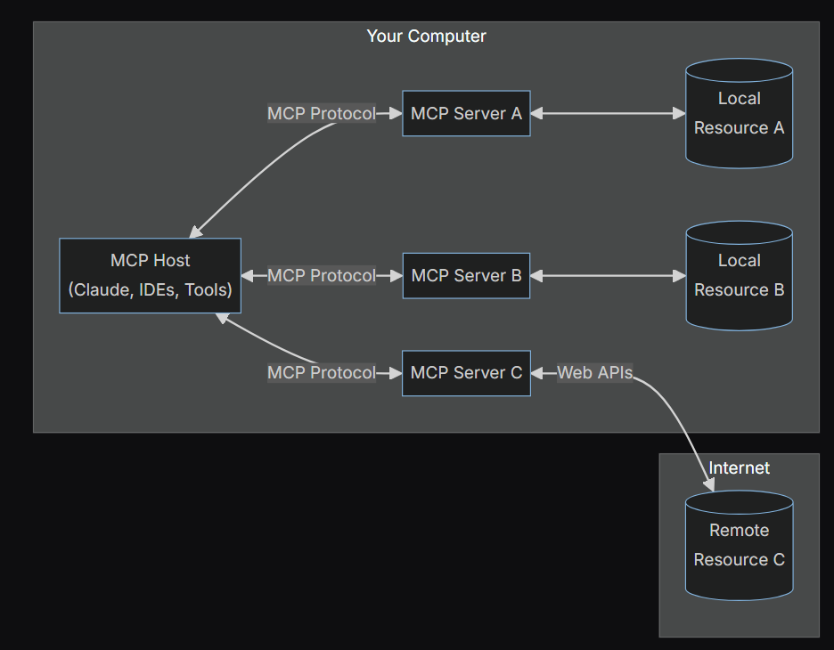
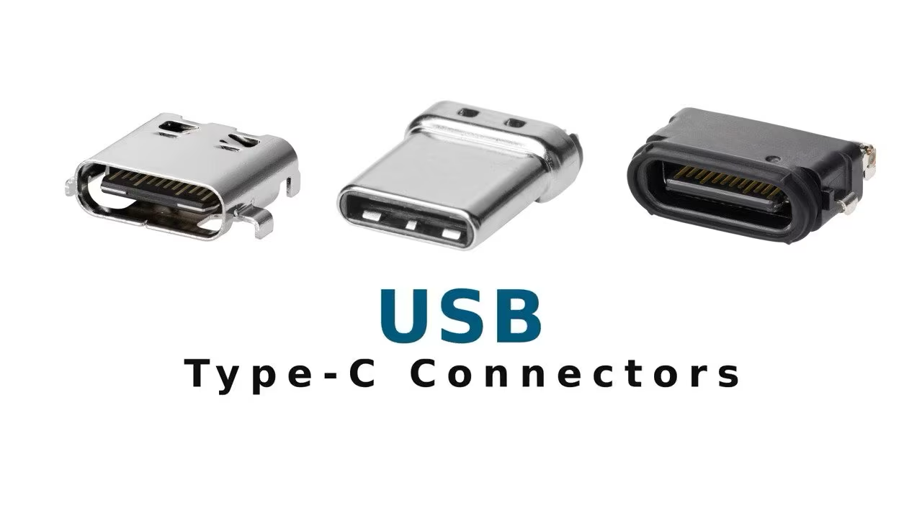
What is the Model Context Protocol?
Open standard “port”
One spec ⇄ any system
Secure & model-agnostic
Notes:
Explain like a port: “LLMs on the left, COBOL cores on the right—MCP is the adapter so they just fit.”
Ask: “Which systems in your org never talk?”

Slide 4
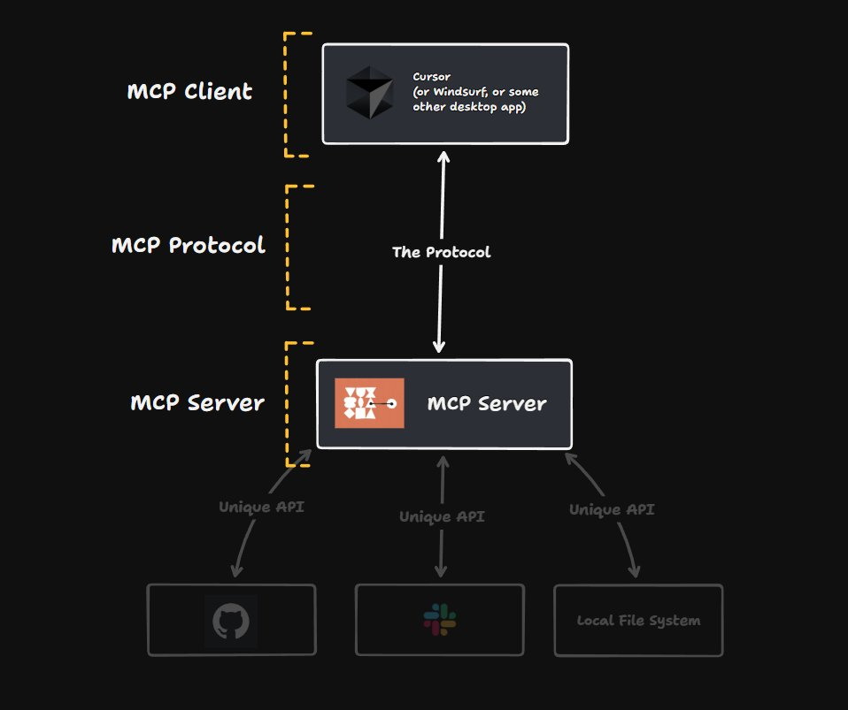
How MCP Works
JSON schema
Auth & audit trail
Maps calls to APIs
Notes:
30-second tech dip; avoid jargon. Remind them Brevity → Get to the point

Slide 5
3 Interoperability Wins
Friction-Free Onboarding
Real-time fraud flags
Hyper-personalised support
Notes:
Tie back to audience pain shared earlier.

Slide 6

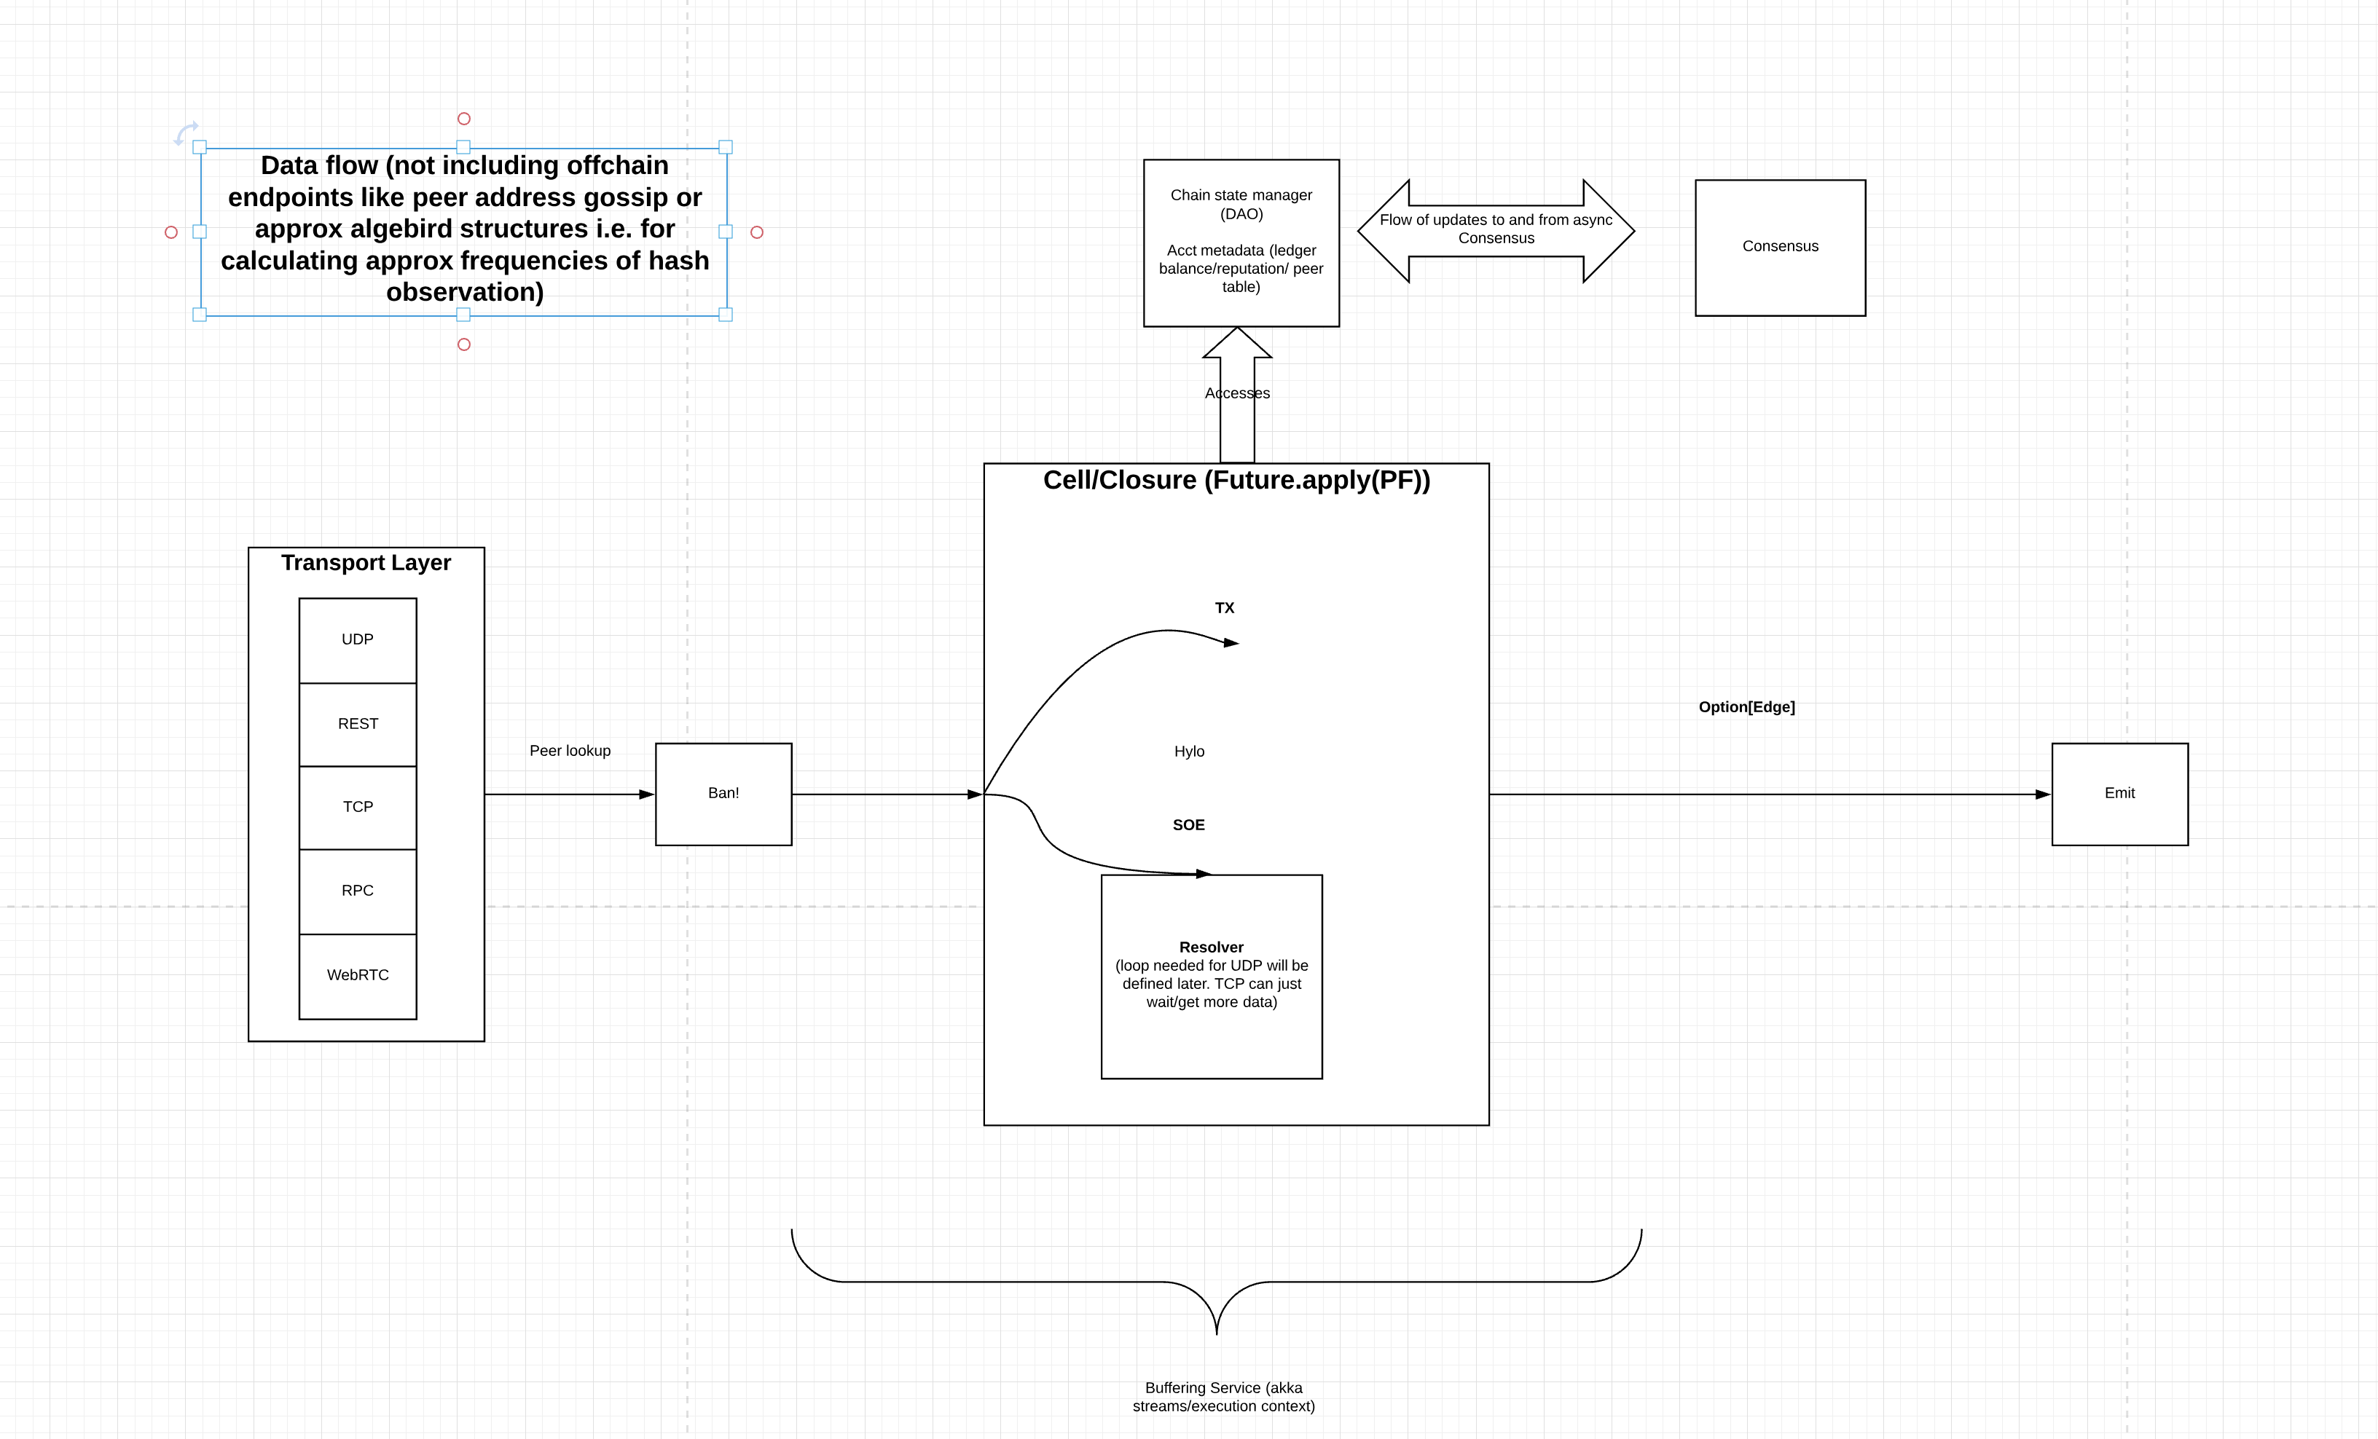
Case Study: Block/Square
“Goose” AI agent
Natural-lang ops
40% faster payouts
Notes:
Paint scenario: ops worker types “release stalled batch” → MCP pipes to legacy rails.
Prompt: “If you had that console, first query you’d run?”

Slide 7
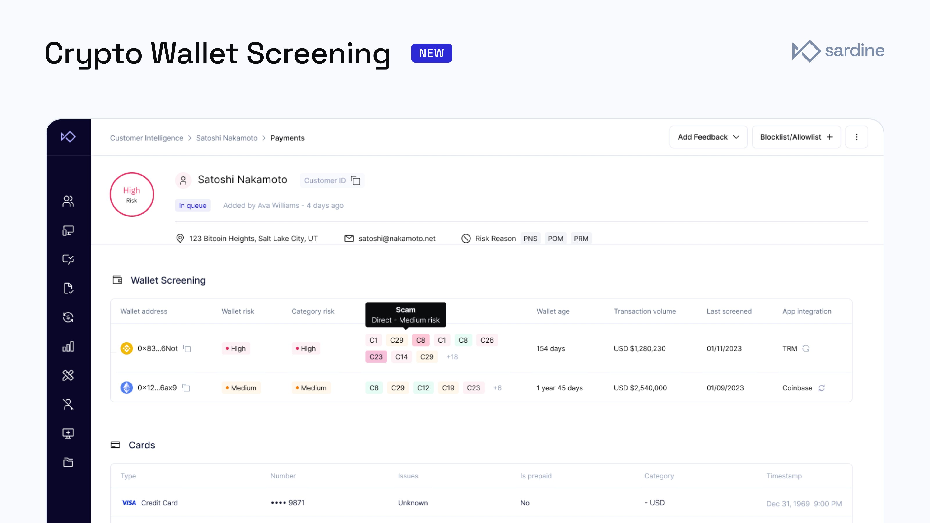
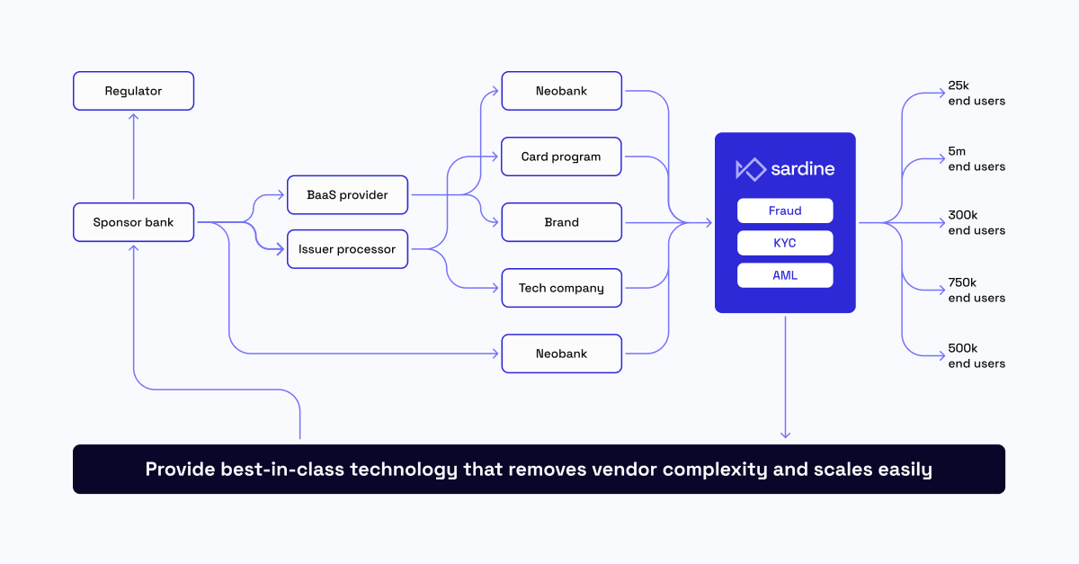
Case Study: Sardine
Risk rules in seconds
MCP server to Issuing API
Less vendor sprawl
Notes:
Link to fraud-team worries. Quick hands-up: “Who fights card fraud daily?”

Slide 8
Fintech Horizon
Stripe & PayPal pilots
Embedded AI agents
Regulators eye audit logs
Notes:
Pendulum approach: swing from possibility to caution to keep energy
Invite: “What would you build if every system had one port?”

Slide 9
Opportunities & Unknowns
Speed, CX, new products
Governance, drift, skills gaps
Notes:
Model Bridging: acknowledge unknowns, ask for concerns, adapt discussion
Say explicitly: “I don’t know everything – and that’s OK.” (Lesson #1.)

Slide 10
Recap & Call to Curiosity
MCP = USB-C for AI
Interoperability boosts trust
Innovation ready now
Notes:
Finish: “Stay curious—ask why and how as you leave.”

Slide 11
Q & A
Notes:
Display the 3-part Bridge (person, facts, feelings) diagram while you field questions

Slide 12
Thank You

Slide 13


Slide 14
